Slide 1


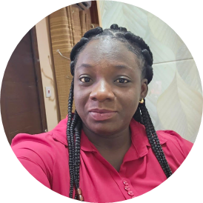
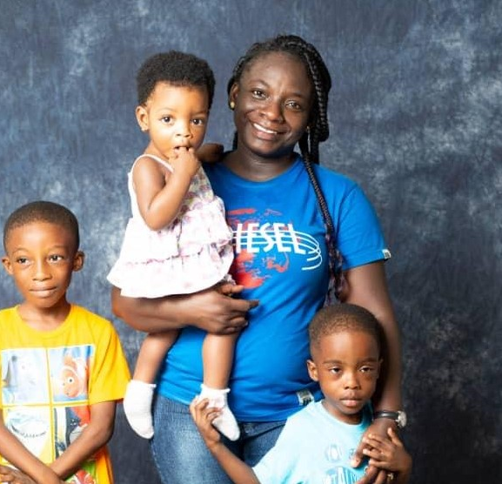
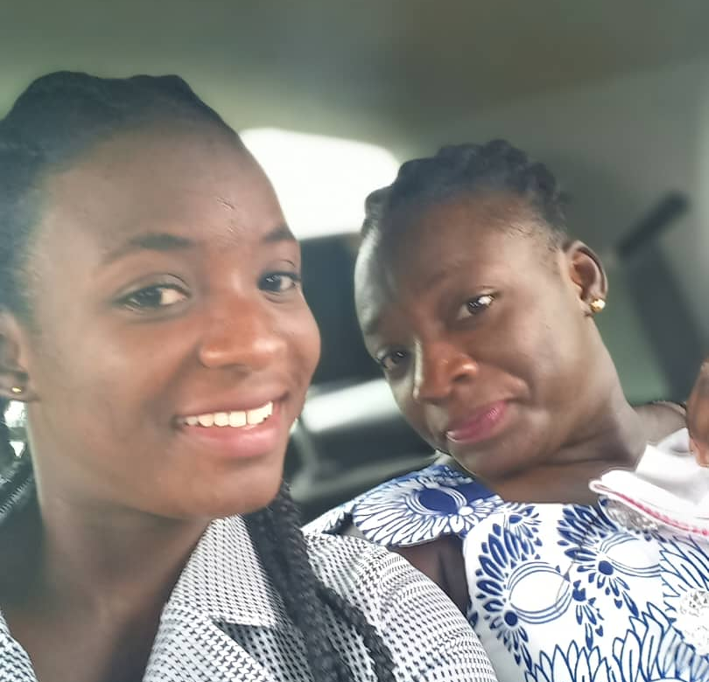
Getting to Know Me
Work
Personal
My role
Sustainability Coordinator for the Lindt Farming Program
Significant others / family members / furry friends in my life
Kofi, Ida, Cyril, Jesse, Elliana and Sonic my dog
Tenure in ofi/Olam
10 years
How I enjoy spending my free time
I love watch to cartoons with my kids and listen to music
Previous companies I have worked at
None
My favorite / comfort food
Banku with Okro stew
Why I joined ofi/Olam and what keeps me here?
I had passion for Agriculture and want to contribute to ofi’s mission on sustainability and Community Impact. Ofi gives room for continuous growth
My favorite song
If tomorrow never comes- Ronan Keating
Hannah
Boateng
I prefer to be called Afrah
Fun fact about me.
I like singing but my voice, hmmm, I’m sure I’m the only one who loves it
This is me outside work, doing stuff I enjoy in my life …

